Slide 1
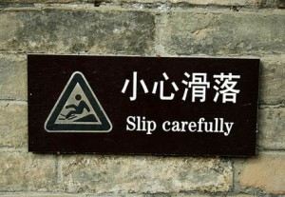
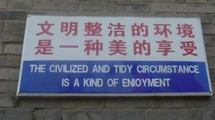
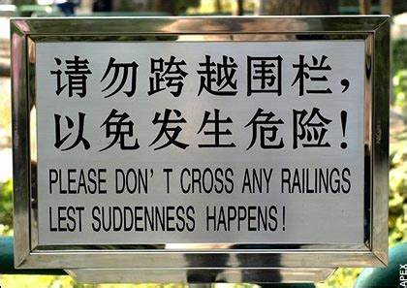

Slide 2
Practical Translation
Beatrice Clegg – Centre for Language Education
cleggbd@sustech.edu.cn

Slide 3
Warm Up How would you translate:
加油
各位老师好
一带一路
中国大陆

Slide 4
What is the purpose of translation? Who is it for?

Slide 5
Chinese English or English Chinese
Which is harder?

Slide 6
What’s the difference?
Chinglish
Chinese English
interlanguage
L1 interference
grammar unintentionally causes confusion or humour
a developing variation of English
increasingly standardised
understandable
expresses Chinese culture
Bad translation
Better translation

Slide 7
(Some) different types of translation
Word for word
Literal
Faithful/semantic
Communicative
Idiomatic
Free

Slide 8
Questions to ask before translating
Who is going to read this?
Why will they be reading it?
How important is it?

Slide 9
Common problems in translation
Typos/grammar errors
Too literal
Unexpected phrasing
Cultural confusion
Pragmatics

Slide 10
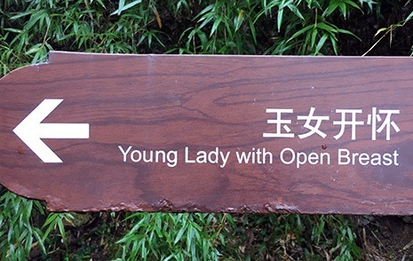
Typos/grammar errors
Too literal
Unexpected phrasing
Cultural confusion
Pragmatics

Slide 11
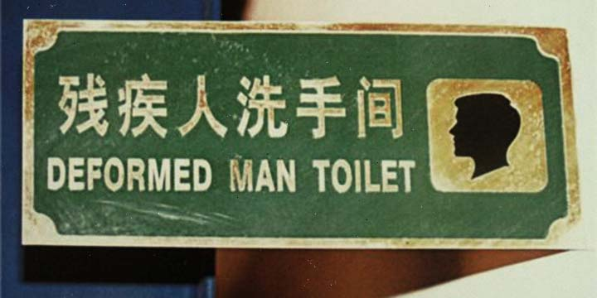
Typos/grammar errors
Too literal
Unexpected phrasing
Cultural confusion
Pragmatics

Slide 12
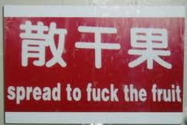
Typos/grammar errors
Too literal
Unexpected phrasing
Cultural confusion
Pragmatics

Slide 13
Examples from SUSTech

Slide 15
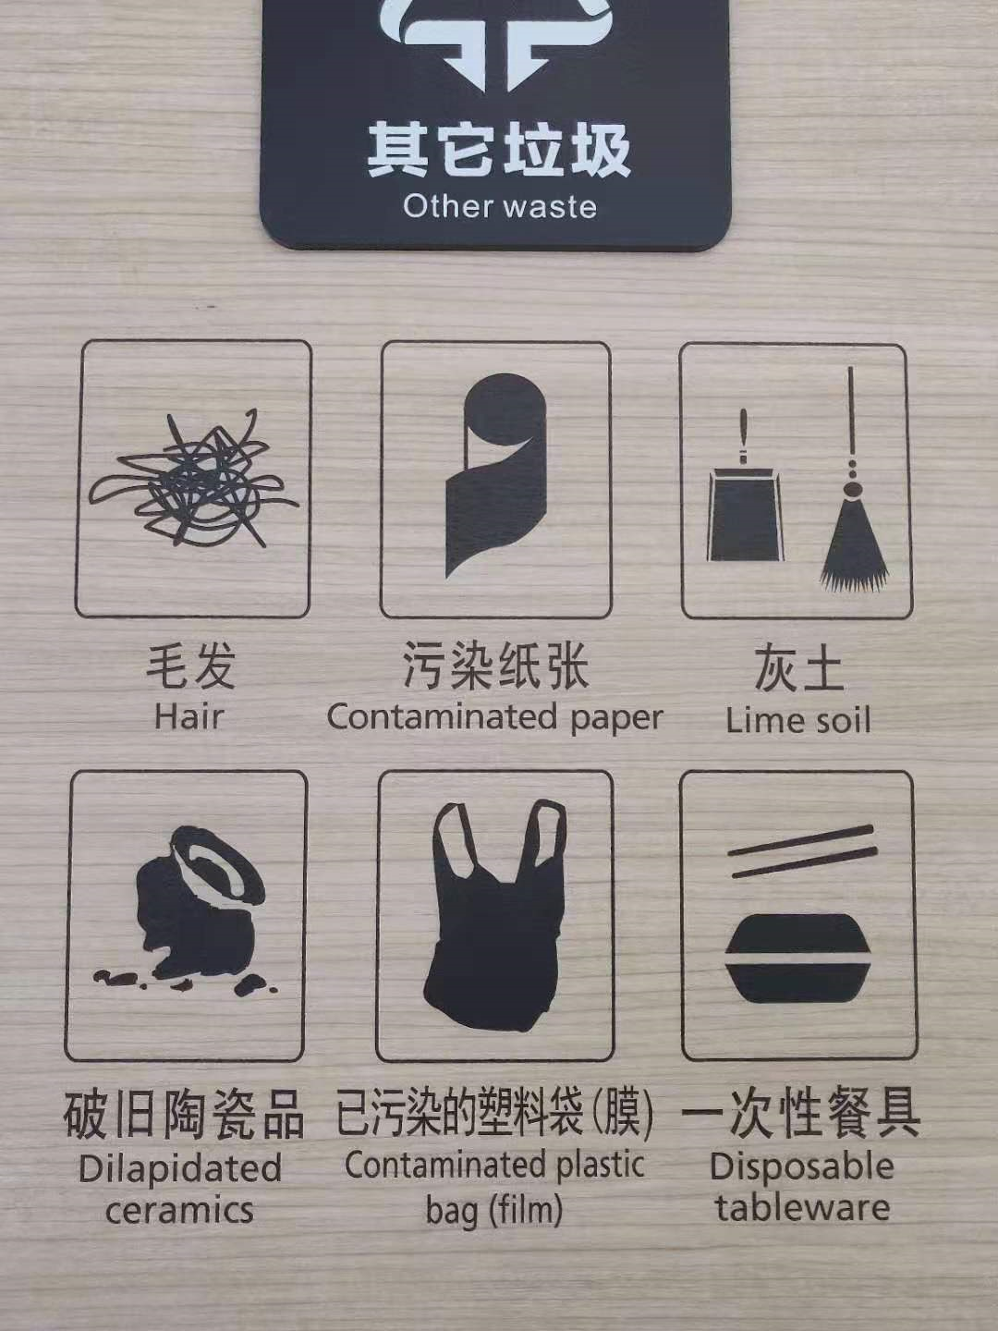

Slide 16
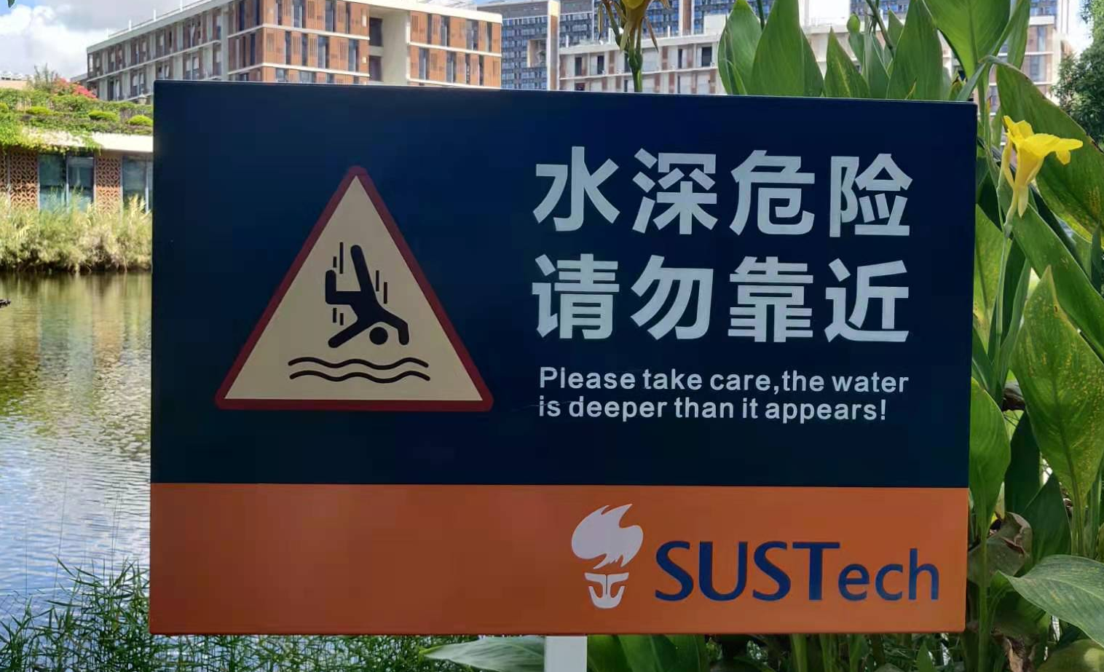

Slide 17
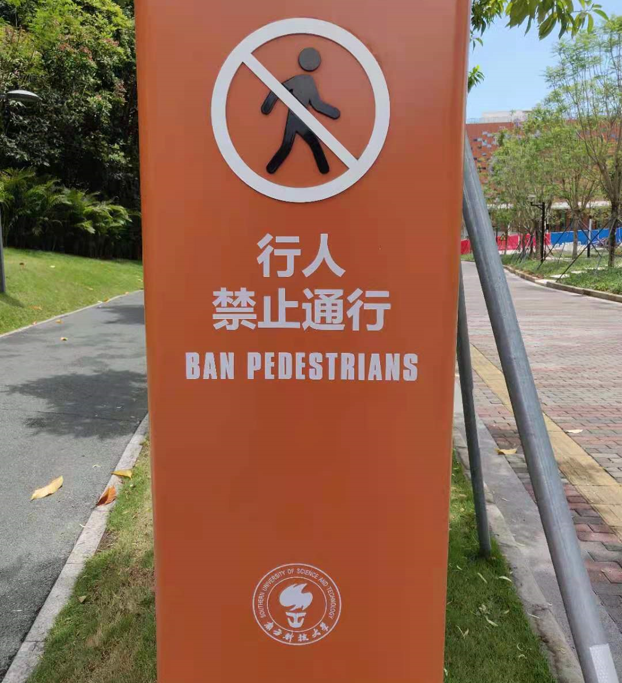

Slide 18
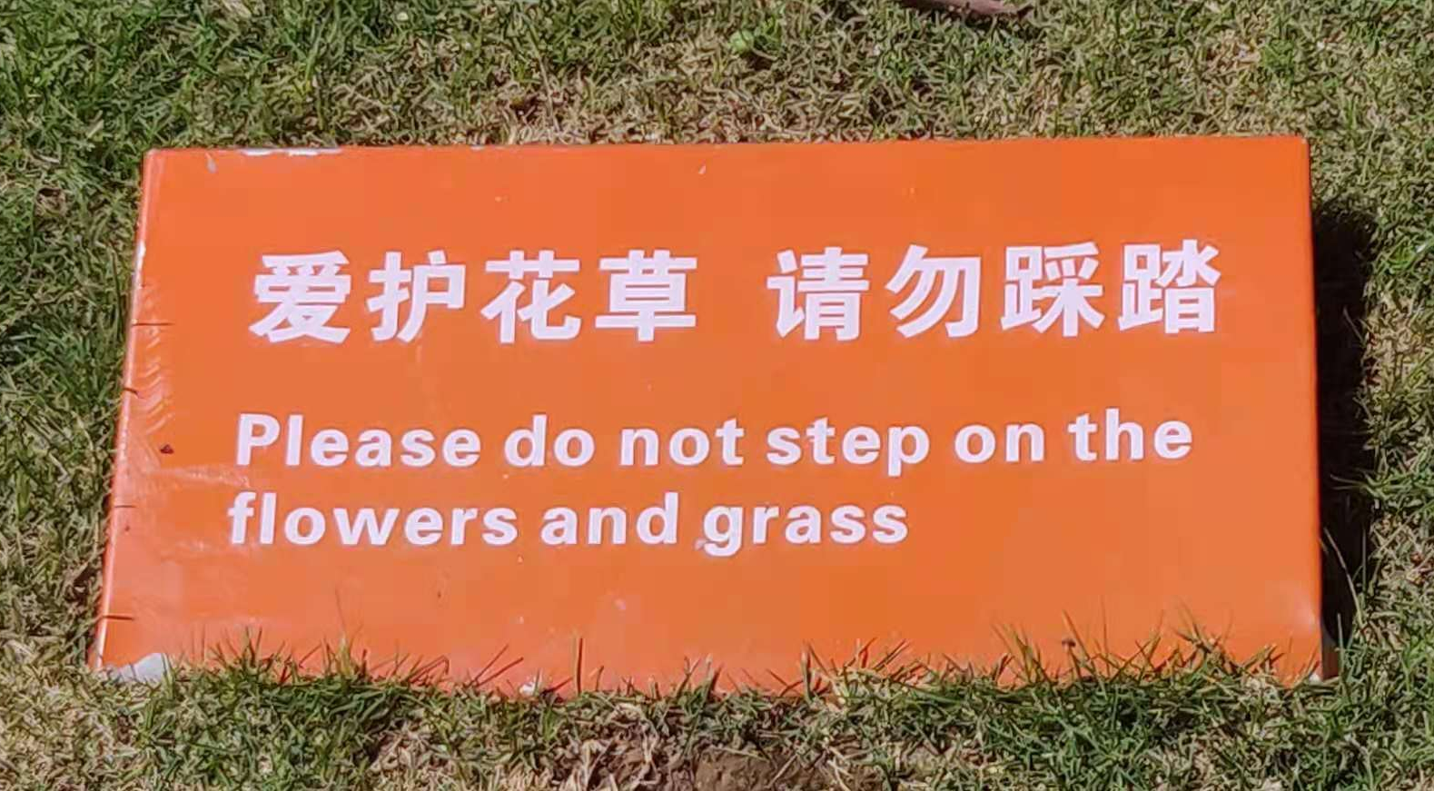

Slide 19
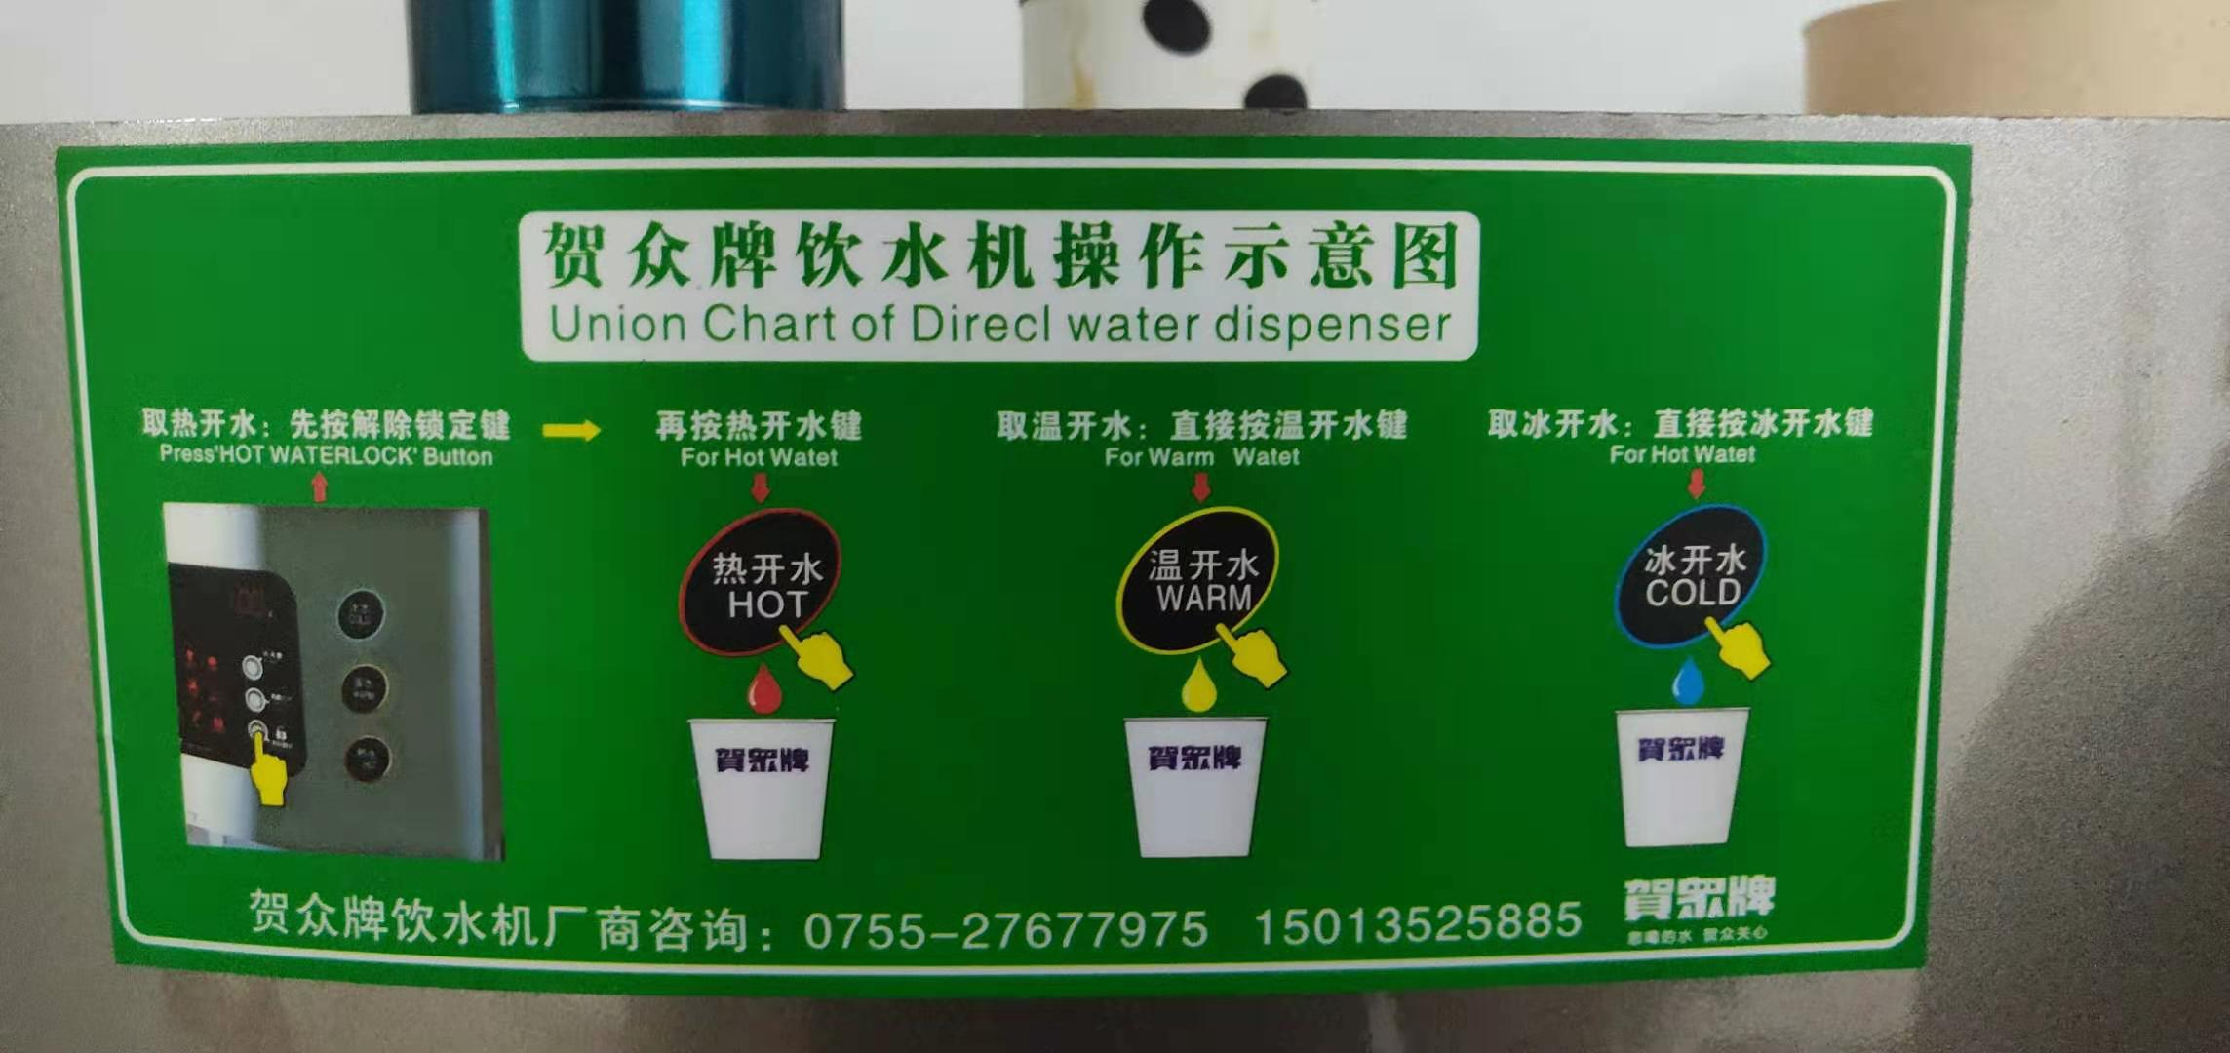

Slide 21
Too literal

Slide 22
Set phrases and collocations

Slide 23
Well received/roger that/get it

Slide 24
Conclusions
Set phrases and co0llocations can be checked online - look it up, what phrasing is generally used in this situation?
A good translation meets the needs of the situation
The audience and the type of message are deciding factors in practical translation

