Slide 1
Greek and Latin Roots: the building blocks of scientific writing
Beatrice Clegg – Centre for Language Education
cleggbd@sustech.edu.cn

Slide 2
What do these characters have in common?
快
恋
惠
怩
怏

Slide 3
What do these words have in common?
Aquarium (水族箱)
Hydrogen (氢气)
Dehydrated (脱水)
Aquamarine (青色)
Hydroelectric (水电)

Slide 4
What do these words have in common?
Aquarium (水族箱)
Hydrogen (氢气)
Dehydrated (脱水)
Aquamarine (青色)
Hydroelectric (水电)

Slide 5
What do these words have in common?
Aquarium (水族箱)
Hydrogen (氢气)
Dehydrated (脱水)
Aquamarine (青色)
Hydroelectric (水电)

Slide 6
Remember these festivals
A
B
All Hallows’ Eve
Bonfire Night
Pancake Day
Epiphany
Saint George’s Day
Saint Patrick’s Day
Saint David’s Day
Saint Andrew’s Day

Slide 7
Why learn Greek and Latin roots?
Greek and Latin roots = English’s radicals (偏旁)
Familiarity when reading
Remembering vocabulary
Grouping
Spelling
Creating new words

Slide 8
Where do we use Latin and Greek in science?
Your card has either an affix (prefix or suffix) or a root
Think of as many scientific words containing your affix or root as you can

Slide 9
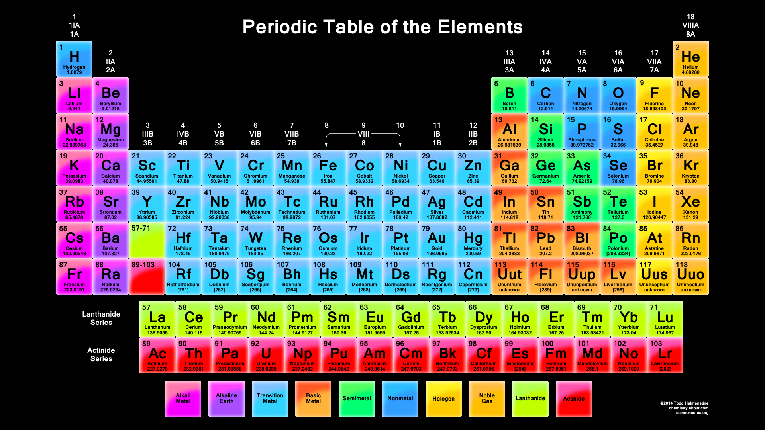

Slide 10
Biology
bio (life) + ology (the study of) = the study of life
photo = light
syn = together
thesis = put/collect
photosynthesis = 光合作用

Slide 11
Chemistry
hydrogen
Hydro = water
Gen = create/origin
When burned hydrogen creates water.

Slide 12
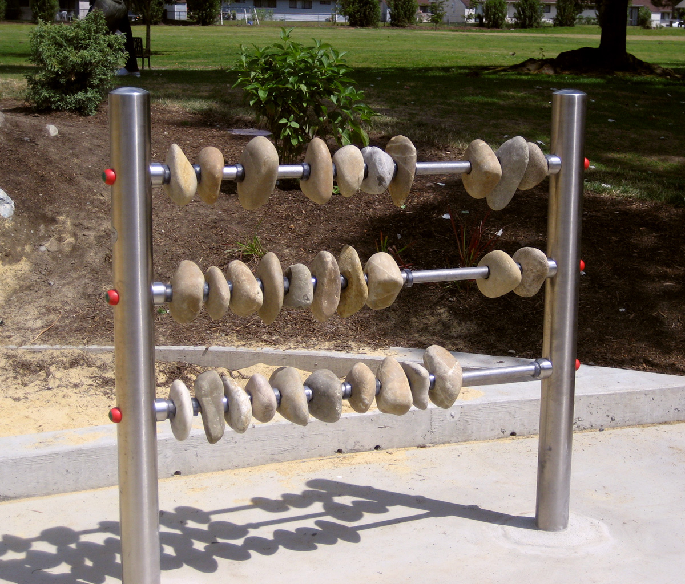
Maths
Calyx = stone
Calculus
Calculate
Calcium

Slide 13
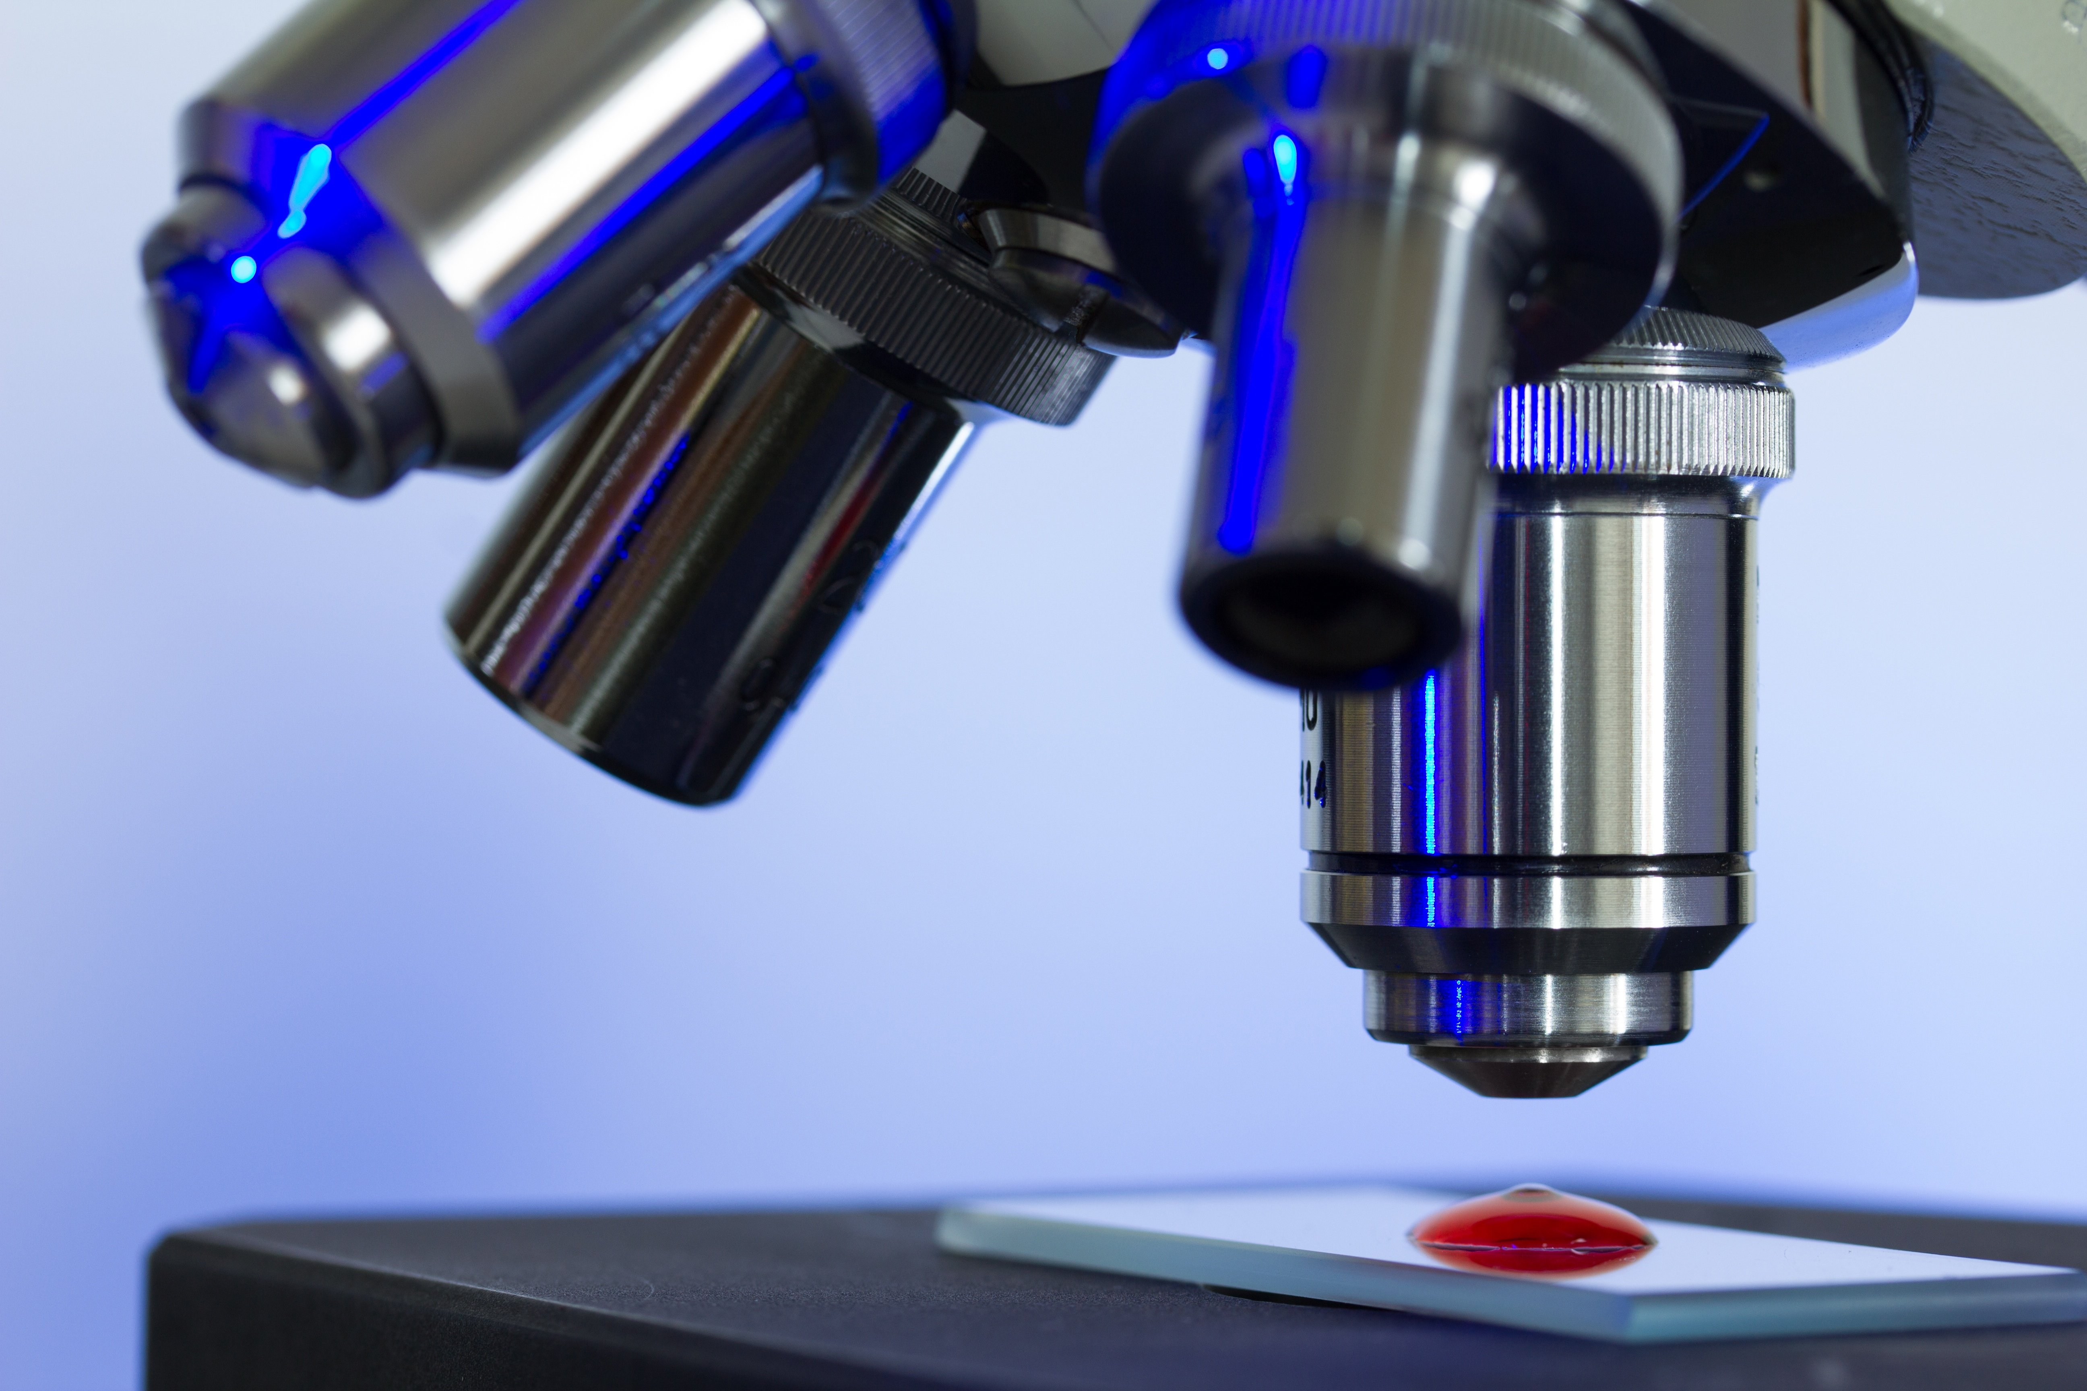
Microscopy
micro - scopy

Slide 14
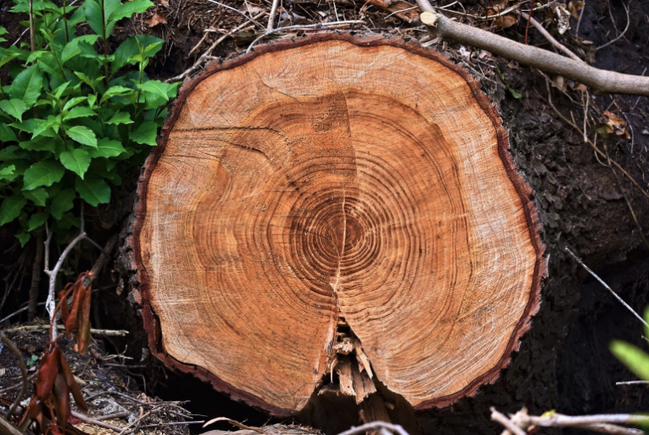
Dendrochronology
Dendro – chrono - ology

Slide 15
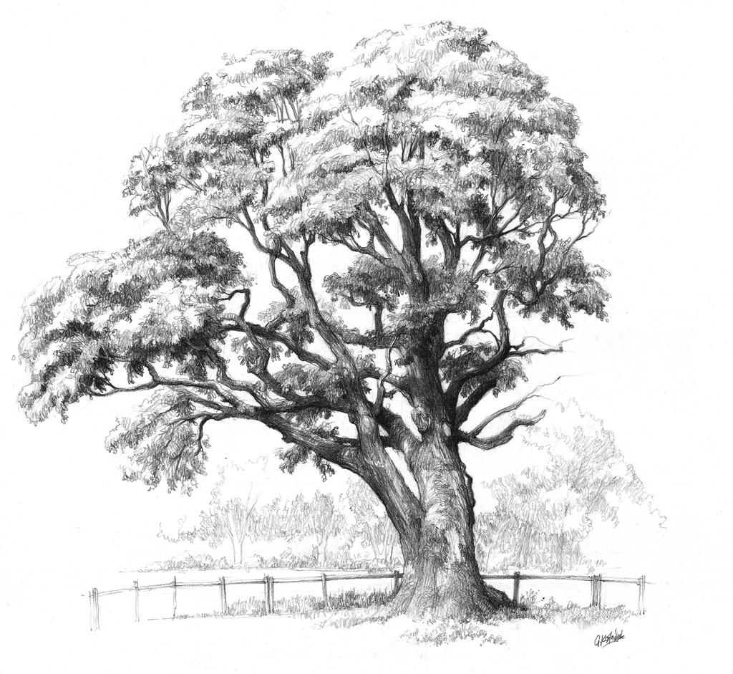
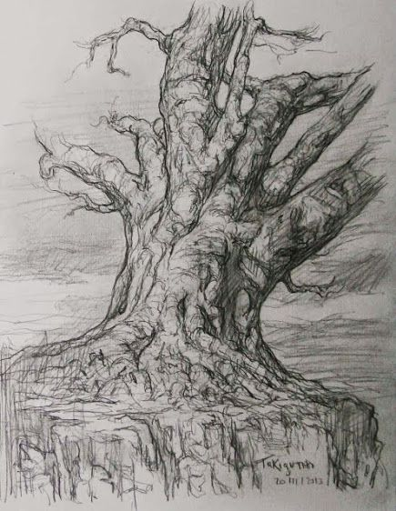
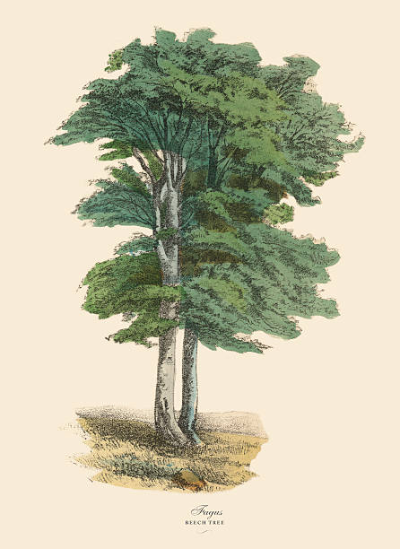
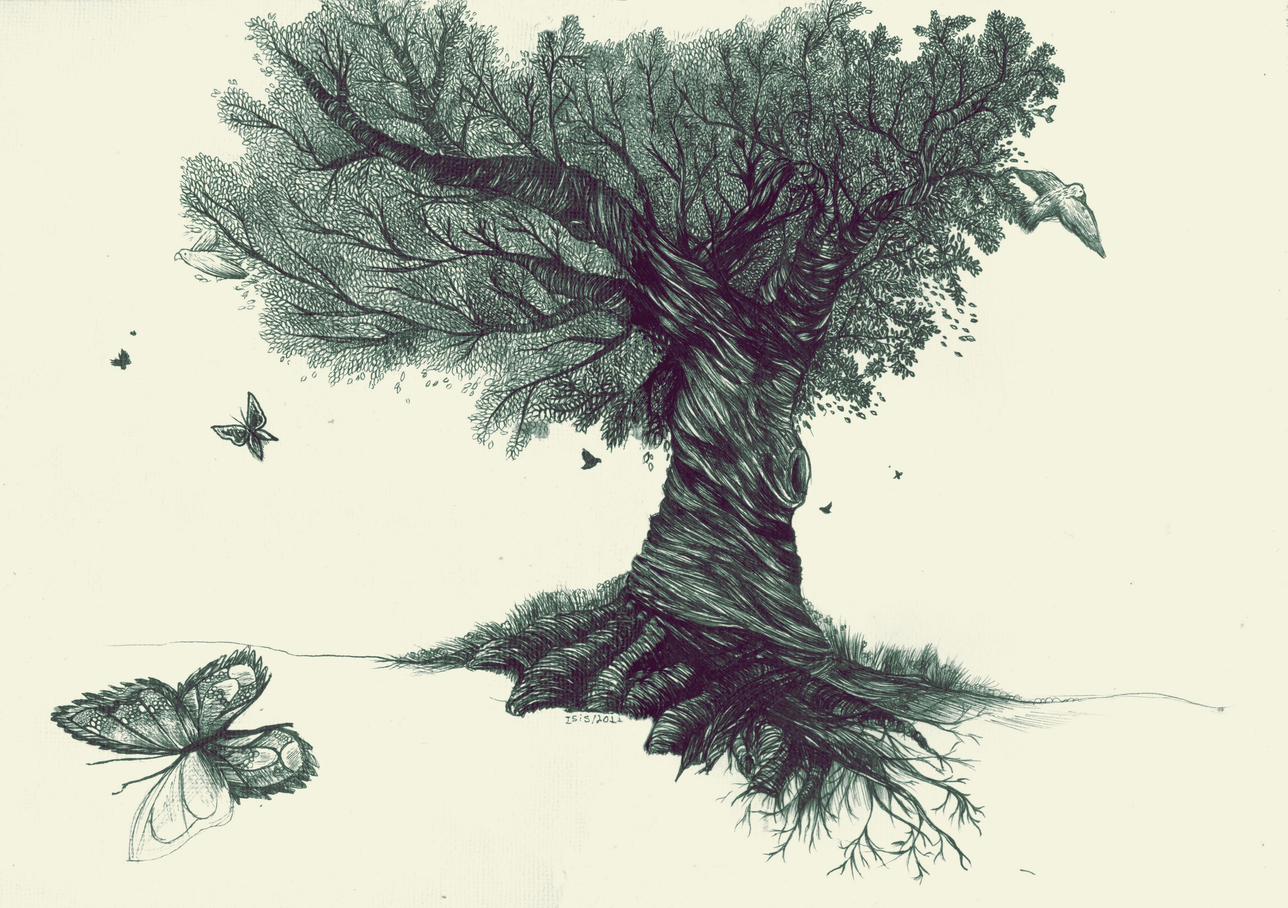
Dendrography dendro - graphy

Slide 16
Making your own words
Find 1 or 2 other people to put your cards together and make a word

Slide 17
Common endings
geography = ?
(geo = Earth)
android =?
(andro = human)
spectrometry = ?
(spectrum = waves)
-metry: measurement
-ism: belief in/theory of
-oid: looks like
-ology: study of
-graphy: writing/drawing of

Slide 18
Conjugating Endings: Verbs to nouns
Latin | Meaning | English | Example
ago/igo | do/drive | -igate/-igation | navigate
facio/ficio | do/make | -fy/-fication | clarify
capio/cipio | take | -cipate/-cipation | participate
navi = boat; clari = clear; parti = part

Slide 19
Conjugating Endings: Diminutives
Latin Ending | English | Example
-culus | -cule | molecule
-uleus | -ule | module
 | -eus | nucleus
mole = mass; modus = measurement; nux = nut

Slide 20
Further Reading on Endings
https://erenow.net/common/
Search Greek and Latin roots of English
https://www.oakton.edu/
Search Latin roots in English

Slide 21
Conclusion
Roots can show us the meaning behind a word, making it easier to understand concepts
Learning building blocks is easier than memorising separate words
Understanding how to conjugate endings improves your spelling and writing accuracy

