Slide 1
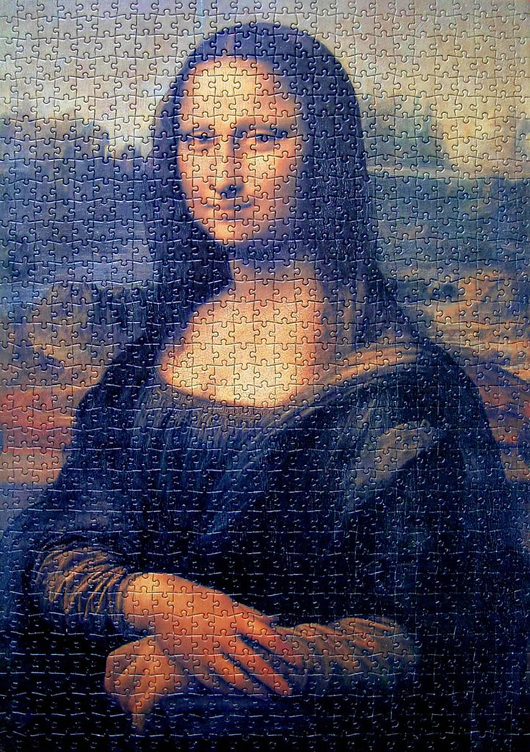
MAKE YOUR WRITING FLOW
Coherence & Cohesion
Xiao Shi
Center for Language Education

Slide 2
Why study coherence & cohesion
4 criterion : Task achievement, coherence and cohesion, lexical resource, grammatical range and accuracy
Is well organized and well developed
Displays unity, progression and coherence.
Avoid redundancy, digression, or unclear connections
Sequences information and ideas logically
Skillful paragraphing: presents a clear central topic within each paragraph
Clear progression of ideas
Uses a range of cohesive devices (transitional signals), referencing, substitution

Slide 3
What is coherence & cohesion
Coherence and cohesion refer to the unity and connectivity of the writing.
Coherent is the connection of ideas being logical, consistent, understandable.
Cohesion is the connection of text elements (words, sentences, paragraphs)
Coherence
A sense of the whole
Macro level (connection of ideas )
Understandable to the reader
Abstract ideas
Cohesion
A sense of flow
Micro level (sentences)
Linking of texts
Observable written content

Slide 4
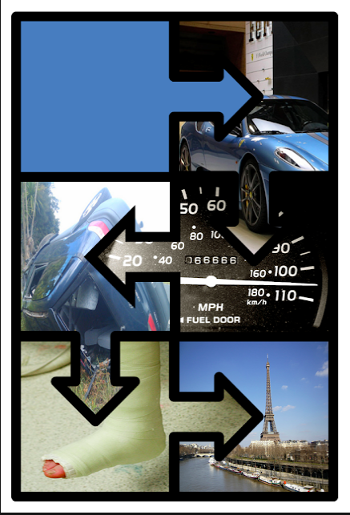
coherence
My favorite color is blue. …
My favorite color is blue. Blue sports cars go very fast. Driving in this way is dangerous and can cause car crashes. I had a car accident once and broke my leg. I was very sad because I had to miss a holiday in Europe because of the injury.
http://andreafarescoaching.blogspot.com/2016/12/coherence-and-cohesion.html

Slide 5
coherence
Cohesion
In a coherent paragraph, all ideas should be logically arranged and presented in good connecting sentences towards the central ideas(topic sentence). Isolated thoughts should be avoided.
incoherent
coherent
Williams, J. S. (2007). Style: Lessons in clarity and grace (9th ed.). New York, NY: Pearson Longman.

Slide 6
coherence
Will Rogers once said, “Advertising is the art of convincing people to spend money they don’t have for something they don’t need.” I really do believe that advertising does manipulate the way that people in our society live. For that reason, I would have to say that advertising is harmful to society. It is also beneficial though I am leaning more towards seeing advertising as harmful to our society. Advertising consumes our thoughts and our ability to make independent decision on what we really need to make us happy. Advertisements lure us into spending money on things that we actually can not afford.
Adopted from http://newsmanager.commpartners.com/tesolc/issues/2012-09-01/

Slide 7
coherence
Will Rogers once said, “Advertising is the art of convincing people to spend money they don’t have for something they don’t need.” I really do believe that advertising does manipulate the way that people in our society live. For that reason, I would have to say that advertising is harmful to society. It is also beneficial though I am leaning more towards seeing advertising as harmful to our society. Advertising consumes our thoughts and our ability to make independent decision on what we really need to make us happy. Advertisements lure us into spending money on things that we actually can not afford.
Adopted from http://newsmanager.commpartners.com/tesolc/issues/2012-09-01/

Slide 8
coherence
Use an outline (thesis statements, topic sentences, summary)
Check unity within paragraphs: all ideas relate to topic sentences.
Check whether your essays match your writing purposes
Peer review

Slide 9
cohesion
My favorite color is blue.
The sky is blue.
Lying on the grass under a clear blue sky makes me relax.

Slide 10
cohesion
My favorite color is blue. I like it because it reminds me of the clear sky in the sunny days. I like to go outside in those days, lie on the grass and look into the blue sky when I am stressed. It relaxes me and takes all my worries away. For this reason, blue is my preferred color.

Slide 11
cohesion
Tip 1 : Put new information last
Farmers try to provide optimal growing conditions for crops by using soil additives to adjust soil pH. Garden lime can be used to raise the pH of the soil. Clay soil, which is naturally acidic, often requires addition of agricultural lime.
Farmers try to provide optimal growing conditions for crops by using soil additives to adjust soil pH. One way to raise the pH of the soil is an additive called garden lime. Garden lime is often added to naturally acidic soils, such as clay soil.
Adapted from https://sites.duke.edu/scientificwriting/lesson-2-cohesion-coherence-and-emphasis/

Slide 12
cohesion
Tip 1: Put new information last
Farmers try to provide optimal growing conditions for crops by using soil additives to adjust soil pH.
Garden lime can be used to raise the pH of the soil.
Clay soil, which is naturally acid, often requires addition of garden lime.
Identify old and new information
Farmers try to provide optimal growing conditions for crops by using soil additives to adjust soil pH.
One way to raise the pH of the soil is an called garden lime.
Garden lime is often added to naturally acidic soils, such as clay soil.
Adapted from https://sites.duke.edu/scientificwriting/lesson-2-cohesion-coherence-and-emphasis/

Slide 13
cohesion
One of an important features of academic writing is cohesion. cohesion can help ensure that your writing coheres or 'sticks together’. When your writing coheres, it is easier for the reader to follow the main ideas in your essay or report. Good cohesion can be achieved by paying attention to five important features. The first important features is reference words. The second key feature is repeated words. The third one is transition signals. The fourth is substitution. The final important aspect is ellipsis.
Adapted from https://www.eapfoundation.com/writing/cohesion/#coherence

Slide 14
Cohesion
Tip 2: Reference /substitution words/ellipsis
Reference/substitution words are used to refer to something that is mentioned earlier in the text. (eg. it, this, these, one, so). Ellipsis means leaving out one or more words, because the meaning is clear from the context
One of an important features of academic writing is cohesion. cohesion can help ensure that your writing coheres or 'sticks together’. When your writing coheres, it is easier for the reader to follow the main ideas in your essay or report. You can achieve good cohesion by paying attention to five important features. The first important features is reference words. The second key feature is repeated words. The third one is transition signals. The fourth is substitution. The final important aspect is ellipsis.
It
which makes it
of these

Slide 15
Cohesion
Tip 3: Repeated words/ideas (synonyms)
One of an important features of academic writing is cohesion. It can help ensure that your writing coheres or 'sticks together’ which makes it easier for the reader to follow the main ideas in your essay or report. Good cohesion can be achieved by paying attention to five important features. The first one of these is reference words. The second key feature is repeated words. The third one is transition signals. The fourth is substitution. The final important aspect is ellipsis.

Slide 16
Cohesion
Tip 4: Transition signals (cohesive devices/linking words)
words or phrases which show the relationship between ideas. (eg, because, therefore, in contrast, first, for example )
One of an important features of academic writing is cohesion. It can help ensure that your writing coheres or 'sticks together’ which makes it easier for the reader to follow the main ideas in your essay or report. Good cohesion can be achieved by paying attention to five important features. The first one of these is reference words. The second key feature is repeated words. The third one is transition signals. The fourth is substitution. The final important aspect is ellipsis.

Slide 17
Cohesion
Cohesion is an important feature of academic writing. It can help ensure that your writing coheres or 'sticks together', which will make it easier for the reader to follow the main ideas in your essay or report. You can achieve good cohesion by paying attention to five important features. The first of these is repeated words. The second key feature is reference words. The third one is transition signals. The fourth is substitution. The final important aspect is ellipsis.

Slide 18
Activity
Coherence: In pair, put the scramble sentences in logical order to make a paragraph
History shows that human beings have come a long way from where they started.
In their long history of development, Human beings have developed various new technologies.
People can now enjoy luxurious life that they previously could not imagined with the help of new technologies.
Disasters may also be the side effect of the development of new technologies.
The development of nuclear weapons may lead to the biggest disaster.
New technologies are causing increasing pollution.
Biodiversity is also threatened by new technologies.

Slide 19
Activity
Cohesion: Rewrite the sentences to make the paragraph cohesive
(order of new and old information, reference, substitution, ellipsis, repeated words and ideas, transitional signals)

Slide 20
Activity
Cohesion: Rewrite the sentences to make the paragraph cohesive
(order of new and old information)
History shows that human beings have come a long way from where they started.
In their long history of development, Human beings have developed various new technologies.
People can now enjoy luxurious life that they previously could not imagined with the help of new technologies.
Disasters may also be the side effect of the development of new technologies.
The development of nuclear weapons may lead to the biggest disaster.
New technologies are causing increasing pollution.
Biodiversity is also threatened by new technologies.

Slide 21
Activity
Cohesion: Rewrite the sentences to make the paragraph cohesive
(order of new and old information)
History shows that human beings have come a long way from where they started.
In their long history of development, Human beings have developed various new technologies.
New technologies allow people to enjoy luxurious life that they previously could not imagined.
New technologies may also lead to future disasters.
The biggest disaster is the development of nuclear weapons.
New technologies are causing increasing pollution.
New technologies also threaten biodiversity.

Slide 22
Activity
Cohesion: Rewrite the sentences to make the paragraph cohesive
(reference, substitution, ellipsis, repeated words and ideas, transitional signals)
History shows that human beings have come a long way from where they started. They have developed various new technologies which allow all human to enjoy luxuries that they previously could not imagined. However, the technologies that are temporarily making this world a better place to live may also lead to future disasters. The biggest one of these is the creation of nuclear weapons. Another destructive result is the increasing pollution. The third is the loss of biodiversity.

Slide 23
Thank you

