Slide 1



Planning Your academic argument
CHU Yu

Slide 2
Answer the following questions.
1. What types of academic writing have you done ?
2. What are the distinguishing features of the academic writing?

Slide 3
Types of academic writing | Distinguishing features of academic writing
Dissertation Reports Proposal Essay Critique Abstract Literature review | Terminology References Citations Argument Evidence Evaluative analysis

Slide 4
Planning your argument
stage 1 Analyse/Choose the title
The most important stage of your planning is to think about what you are going to write about.
A title is given to you.
You need to choose your own title.

Slide 5


Planning your argument
stage 1.1 Analyse the title
Most titles contain two parts:
the topic
some form of instruction Practice:
Identify the two parts of the following essay title and decide what you are being asked to do.
Example Title:
To what extent do reflective journals augment the learning process?

Slide 6

Stage 1 Analyse the title
To what extent do reflective journals augment the learning process?
Topic:
Reflective journals
Instruction(s):
Do reflective journals actually augment the learning process? If yes, to what extent?

Slide 7
Stage 1.2 Choose your own title
One helpful strategy is to use a Topic T-Chart
Brainstorm ideas of things you care about
•
Make a list on a T-Chart

Slide 8
Topic T-Chart Strategy
Make a T-Chart on a piece of paper and brainstorm a list of ideas. Write things you “like” and things you “hate” about your research/life
•
Like Hate
Share your “likes” and “hates” with a partner.
Identify which “like” or “hate” do you feel strongest about?

Slide 9
Let’s try another one.
Typical academic research experiences and unusual experiences.
Typical
Unusual
Share your “typical” and “unusual” life experiences with a partner. Identify which experience you feel strongest about.

Slide 10
Other things you might explore for title ideas…
Important/Not Important
Things that are very important to your research and things that are not that important.
Change/Stay the Same
Things you might want to change in your research area and
things you want to stay the same.
National RtI Writing Demonstration Project

Slide 11
After you have made a list of possible ideas, it is time to pick your topic.
Pick something that you…
have strong feelings about; know a lot about;
think will interest your audience; and
think will be worth reading for your audience.
think can be researchable ;
National RtI Writing Demonstration Project

Slide 12

Planning your argument
Stage 2 Read around the topic
First: general reading
Focused reading
Yes No
No difference Hinder
Comparison with other reflective practices
Issue
e.g. in nursery
school
Reflective journal
Issue
Issue

Slide 13
Planning your argument
Stage 2 Read around the topic
When we prepare to write academically we need to become active readers
Being an active reader involves asking questions about what we read
Is it true – is there any evidence for this? Is it relevant to my own area of study?
Is it biased – how do I recognize bias?
Can you think of other questions you could ask as you read?

Slide 14

Planning your argument
Stage 3 Decide your thesis
Title: To what extent do reflective journals augment the learning process?
After reading ( general and focus reading), we should be able to decide our thesis.
For example:
Reflective Journals augment the learning process by helping learners to think strategically about how to improve their own learning and performance

Slide 15

Planning your argument
Stage 4 Brainstorm ideas
Idea 1
Idea 3
R e f l e c t i v e J o u r n a l s
Idea1.1
augment the process by
l e a r n e r s t o
learning helping t h i n k
Idea 3.1
Idea 2
strategically about how to improve their own learning and performance
Idea 2.1

Slide 16
Planning your argument
Stage 5 Formulating argument
An argument = Thesis + reasons(from your reading,
or own research)
•
For example:
Thesis: Reflective Journals augment the learning process by helping learners to think strategically about how to improve their own learning and performance
Reason 1: Help give insight into own patterns of learning and monitor progress (plus evidence)
Reason 2: Help identify areas for improvement and plan changes (plus evidence)

Slide 17
Planning your argument
Stage 5 construct the argument
Method 1 – analyses alternate views in detail ARGUMENT A
Point 1
Point 2
Point 3
…
ARGUMENT B(Counterargument)
Counter-Point 1
Counter-Point 2
…

Slide 18
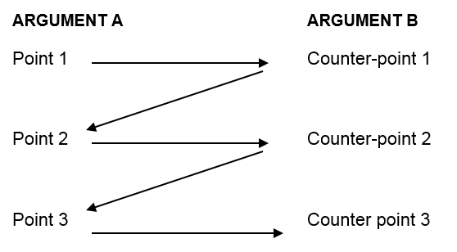
Planning your argument
Stage 5 construct the argument
Method 2 – this method is more analytical and enables the writer to keep reinforcing his own point of view.

Slide 19

Now, you are ready to start writing.

