Slide 1
Academic word list
Center for Language Education
English for Academic Purposes Workshop Series
Xiao Shi

Slide 2
Form a study group
A group of 5 persons
Get to know each other
Name
Purpose
What is academic words, give some examples.

Slide 3
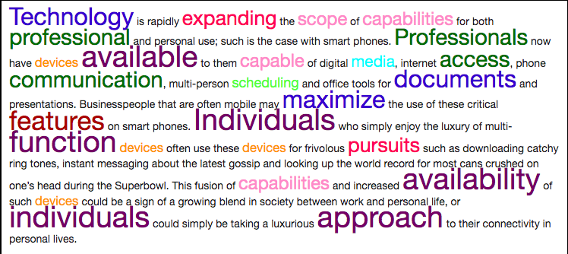
What is Academic word list
Arboreal
Centrifuge
Pastiche
Incumbents
Verbiage

Slide 4
What is Academic word list
Coxhead(2000) studied over 3.5 million words of academic text from 28 subject-areas and made:
Academic word list (AWL): 10% of the academic texts
General service list (GSL): 80%
Specific words related to subject: 5%
Less frequent words: 5%
Coxhead, A. (2000) A New Academic Word List. TESOL Quarterly, 34(2): 213-238
https://www.wgtn.ac.nz/lals/resources/academicwordlist/information/principles

Slide 5
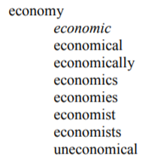
What is Academic word list
570 word families
divided into 10 sublists
high frequency in academic contexts
Coxhead, Averil (2000) A New Academic Word List. TESOL Quarterly, 34(2): 213-238
https://www.wgtn.ac.nz/lals/resources/academicwordlist/information/principles

Slide 6
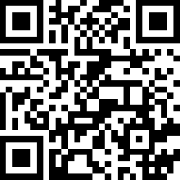
How to learn the words?
Learn the meaning and use of the headwords
Learn the word family and make you own sentence
Choose one word from the word family
Explain the word
Synonyms
Make a sentence
1.1 area
1.2 available
1.3 concept
1.4 consist
1.5 benefit
1.6 authority
1.7 approach
1.8 assess
1.9 analyse
1.10 assume
2.1 benefits
2.2 analyzed
2.3 concept
2.4 areas
2.5 available
2.6 approaching
2.7 assumed
2.8 authority
2.9 consists
2.10 assessing

Slide 7
How to learn the words?
analyse analyser analysis analyst analytic analytical analyze | approach approachable approached approaches approaching unapproachable | concept conception conceptual conceptualisation conceptualise | consist consistency consistent inconsistency inconsistent
authority authoritative authorities | assess assessable assessment reassess reassessment | assume assumption assumptions | available availability unavailable
 |  |  | benefit beneficial beneficiary

Slide 8
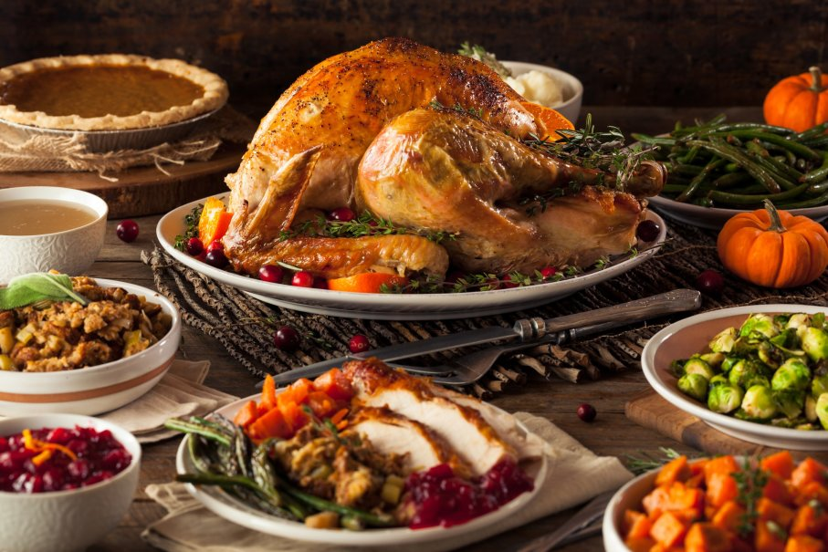
How to Use the words?
Use one of the words to talk about the picture
https://people.howstuffworks.com/culture-traditions/holidays-other/thanksgiving.htm

Slide 9
How to Use the words?
Use one of the words to talk about the picture
http://www.reshareable.tv/funny-dog-photos-will-inspire-hit-gym.html

Slide 10
How to Use the words?
Use one of the words to talk about the picture
https://www.vectorstock.com/royalty-free-vector/boy-cartoon-doing-chemical-experiment-vector-1633700

Slide 11
How to Use the words?
Use one of the words to talk about the picture
https://phys.org/news/2019-05-maths.html

Slide 12
How to Use the words?
Use one of the words to talk about the picture

Slide 13
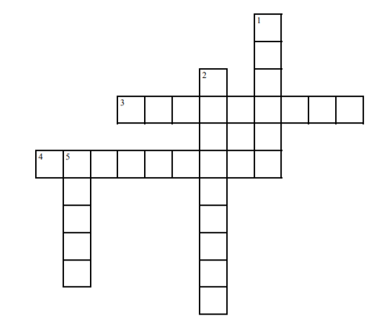
How to learn the words?
Step One
Complete the crossword puzzle as a group
Take one word and study the word (meaning, synonym, a sentence)
Take turn to
Explain your word to your group mates(don’t say or spell the word directly
After your group mates guess out the word, write it down on the crossword
Share the sample sentence you made and write the sentence down on crossword sheet

Slide 14
How to Use the words?
Step two
Talk about a picture with the words
Choose one picture from you phone and use one of the five words in the crossword puzzle to talk about the picture
Share your picture with the group
have your peers make sentences using the words to talk about your picture.
Then share your sentence

Slide 15
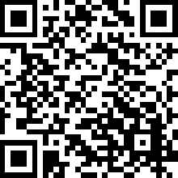
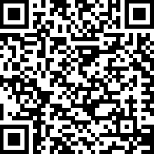
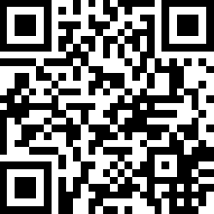
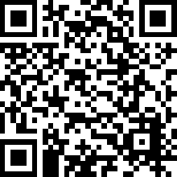
Resources
AWL FULL LIST
AWL exercise
IELTS BUDDY
Using English for Academic Purposes For Students in Higher Education
EAP Foundation
https://www.wgtn.ac.nz/lals/resources/academicwordlist/publications/awlsublists1.pdf
https://www.eapfoundation.com/vocab/academic/tagcloud/
https://www.ieltsbuddy.com/academic-word-list-sublist-8a.html
http://www.uefap.com/vocab/vocfram.htm

