Slide 1
“Practical Email Writing”
Matthew Jellick
Assistant Director
Center for Language Education

Slide 2
Personal Star
California
Brad Pitt
September 2, 19…
TA’s and Staff
Tacos

Slide 4
When?
Essay
Email
Text
Phone

Slide 5
Emails: Subject/Body/Signatures/Attachments

Slide 6
Subject Lines
Keep it short and simple! They will get cut off if they're too long, especially on phones…
Use personalization if possible…
Finally, don’t write your Subject Lines in red (it doesn’t make anything any more important)

Slide 7
Cc vs. Bcc
Carbon Copy (Cc)
Blind Carbon Copy (Bcc)
Everyone in the email list can see who else the email was sent to
If everyone knows each other, then this is a good choice.
You want someone else to receive a copy of an email, but they aren’t one of the primary recipients.
You want the recipients of the message to know the other people who have been sent the message.
No one (except for the sender) knows who else got the email
If people don’t know each other, this may be a better choice
You want someone else to receive an email, but you don’t want the primary recipients of the email to see you’ve sent this other person a copy.

Slide 8
Proper “Fwd.” Technique
When “Forwarding”, make sure to take the time to write a personal comment at the top of your forwarded email to the person you are sending to.
Don’t just simply hit “forward” without adding your own context to it. That shows the recipient that it isn’t personal and, perhaps not that important.

Slide 9
Recipient's Name:
Professional
Dr.
Professor
Personal
Mrs.
Informal
Dear
First Name
Ms.

Slide 10
Order of Importance
President
Vice President
Dean
Director
Assistant Director
Provost

Slide 11
Email Body

Slide 12
What about you??
Who are you?!
Be sure to introduce yourself in the email, letting the recipient know who exactly you are, which helps them understand why you are writing the email.
Ex.: I am Matthew, in your Monday morning English class

Slide 13
ALL CAPS!!!
Writing in all capitals can be conveyed that you are shouting at your email recipient, and nobody likes to be yelled at! Consider other ways to get your message across while still letting them know it is important. Using all capitals can bother people and in turn, they can yell back at you…

Slide 14
Tone
Ask, don’t Demand
View the email as an informal request of information rather than a threat for something
Be patient and kind in your request

Slide 15
“24-Hour Rule”
If you’re:
Upset
Angry
Hear-broken
Or simply haven’t eaten
Don’t send the email!
Wait a day and sleep on it…you will regret sending an angry email

Slide 16
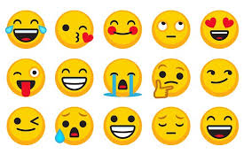
Abrevs. & Emoticons
Use both abbreviations and emoticons sparingly, especially in a professional email!
Not everyone understands your abbreviations and not everyone appreciates emoticons!

Slide 17
Acronyms in an Email:
Try to write out the entire words first before using an acronym:
Southern University of Science and Technology (SUSTech)
Test of English as a Foreign Language (TOEFL)

Slide 18
Email Signatures
Good News…
Bad News…
Whenever you are writing an email about something such as a day off, party, or good news, how would you sign off?
Respectfully,
Regards,
Best,
If you are writing an email about an exam, additional assignment or even work on Saturday, how would you sign off?
Best,
Kisses,
Regards,

Slide 19
Email Signatures (continued)
Department
Individual
School of Innovation and Entrepreneurship
南方科技大学
深圳市南山区学苑大道1088号
Matthew Jellick
Have a Happy Qing Ming Festival
Matthew Jellick
Happy Monday☺
Matthew Jellick
“Those who strive, find success”

Slide 20
Email Attachments
Are the files absolutely necessary?
If there are related files, consider creating a .zip drive instead of having 10 different attachments
If there are multiple pictures, try using a photo-sharing website as opposed to a long list of individual .jpg files
If you translate the email, translate the attachments!
What is the difference between .dox and .pdf?
Make sure your attachment file includes relevant information (ex.: 123413535434.jpg -or- document1.dox)

Slide 21
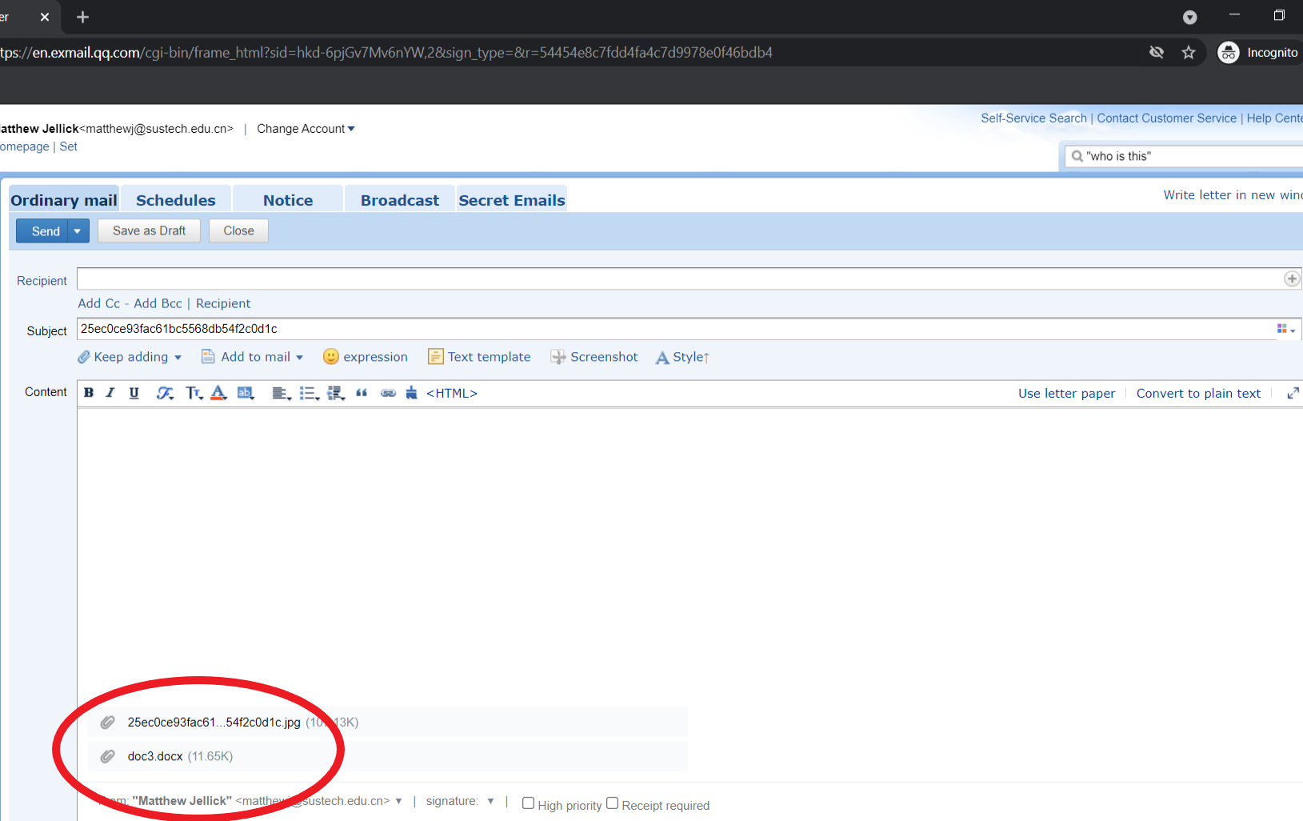

Slide 22
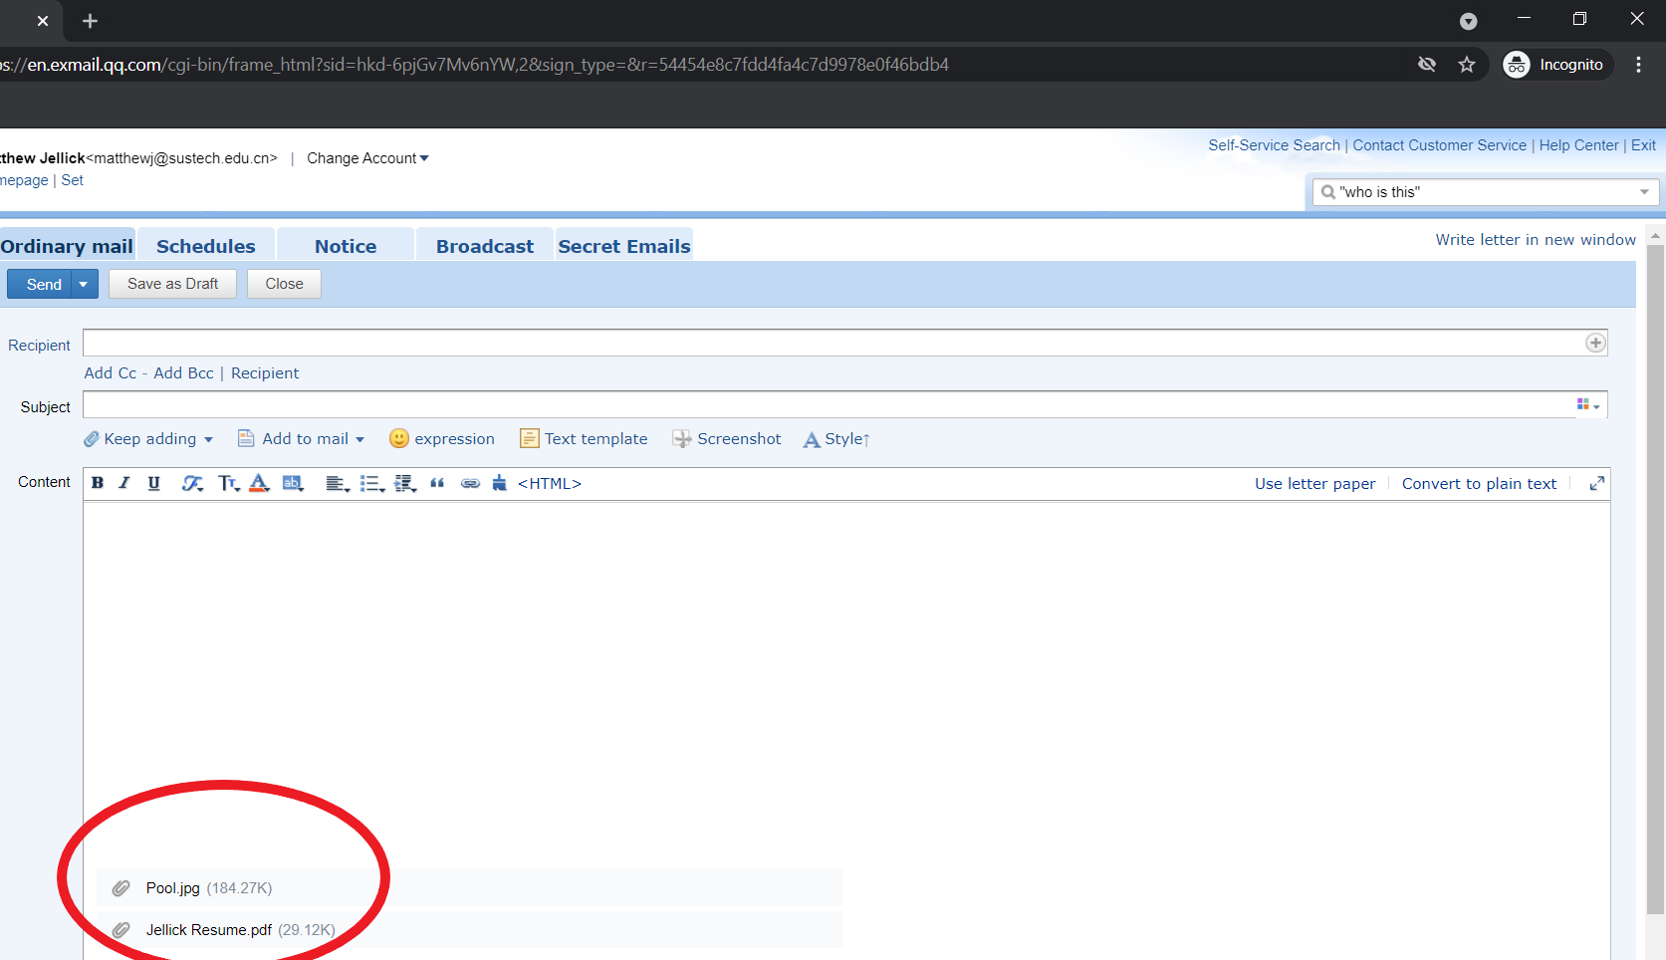

Slide 23
Links
When attaching a “link” be sure to do the following:
Double-check your link on a different browser so that you are sure it links directly to the website you want.
“Label” the link with something specific, not simply the URL
Ex.: Matthew Jellick Blog Posts
NOT
https://matthewjellick.wordpress.com/

Slide 24
Timing
Respect people’s time!
Assume that normal “working” hours are between 9am and 5pm (in China, people usually take a break from 12pm – 2pm)
Sending an email on a Friday at 6pm isn’t a good practice
Remember time zones when emailing to US universities
It does not mean you are “diligent” because you send an email at 11pm, it means you have bad time management!

Slide 25
Thank You
Matthew Jellick

