Slide 1
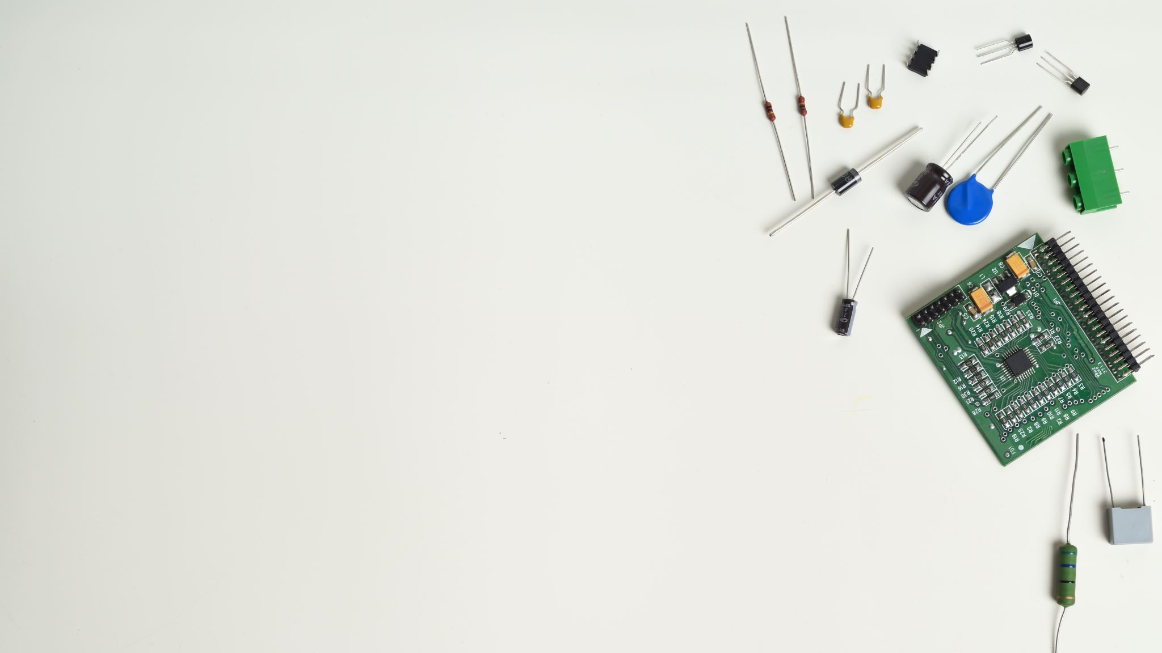
Topic Selection Transferring your Passion to Presentations and papers
Matthew Jellick
Center for Language Education

Slide 2
Passion
(noun):
A strong feeling or enthusiasm for something or about doing something
Merriam Webster Dictionary

Slide 3
Major
(verb):
Specialize in (a particular subject) at college or university
Oxford Dictionary

Slide 4
What is your Passion?
In as few words as possible (less than 5) write down your passion on the Post-It Note at your desk

Slide 5
experatus.com

Slide 6
Presentation & Paper Parameters
Length (Slides, Time, Word Count, Page Numbers)
Discipline (Social Sciences, “Hard” Sciences, Languages)
Co-Presenter/Author (Individual, Paired, Grouped)
Audience (Classmates, Teacher, Editorial Panel)

Slide 7
Topics your audience is interested in
Topics you are passionate about
Topics you know about

Slide 8
How to select a research topic
Not too broad
Sparks your interest
Data collection
Solves a contextual problem
Not too specific
Know the requirement
Align with current trends of research
Relevant to your field

Slide 9
Theoretical & Practical Approaches

Slide 10
Step 1: Requirements
Must be argumentative
5 Page Minimum
Use 5 Peer-reviewed sources

Slide 11
Step 2: Interests
Art
Economics
Music
Thermonuclear Dynamics

Slide 12
Step 3: Researchable
Topics Focus:
Who?
What?
Where?
Why
How?

Slide 13
Exporters of foreign trade
Impact of slower economies
China/US
Pandemic
The result of declining trade between economies due to the economic impact of the pandemic

Slide 14
Remember!
This process is a learning experience for you (the researcher) as well as for the audience!

Slide 15
Practical Issues

Slide 16
What “type” of Presentation/Paper?
Expository: Presents Facts
Example: The social and economic impacts of Climate Change
Persuasive: Aims to Convince
Example: The need to reduce our Carbon Footprint

Slide 17
Presentation/Paper Design
Presentations:
Number of Slides
Length of Speaking
Papers:
Number of Pages
Number of References

Slide 18
Papers
Brainstorming
Outlining
Thesis
Introduction
Research
Conclusion

Slide 19
Remember!
This process is a learning experience for you (the researcher) as well as for the audience!

Slide 20
CLE Workshops
EAP
Writing Center

Slide 21
Contact Information
Name:
Matthew Jellick
Email: matthewj@sustech.edu.cn
Office:
Wisdom Valley, Building 3, Room 202

Slide 22
Thanks

